Slide 1
Deep Learning for Real-Time Quality Characterization of Ultrasonic B-scans from Resistance Spot Welds
Ryan Scott, Danilo Stocco, Andriy Chertov, Roman Gr. Maev, Sangyun Yoo, Sung Hoon Jung

Slide 2
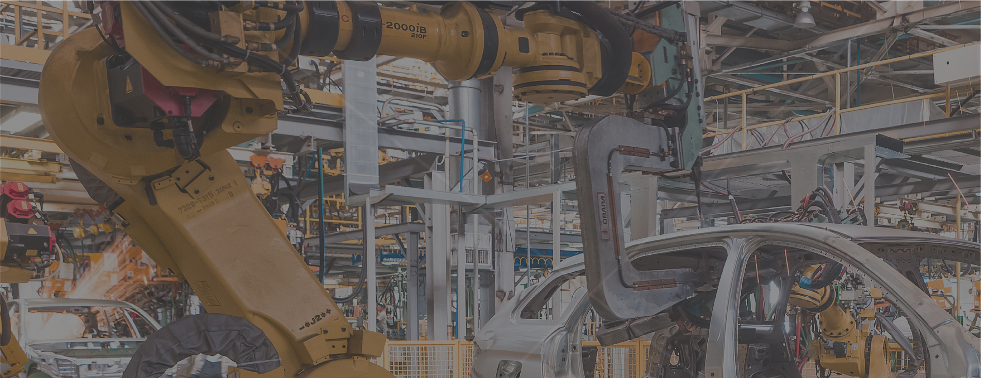
Automotive Body Assembly
Extremely fast-paced environment
Key process: Resistance Spot Welding
Robotized
Fast
75-600ms per weld with <1s downtime between welds
Welds vary in terms of criticality
Lots of variance in process/geometry
Would greatly benefit from adaptive process control

Slide 3
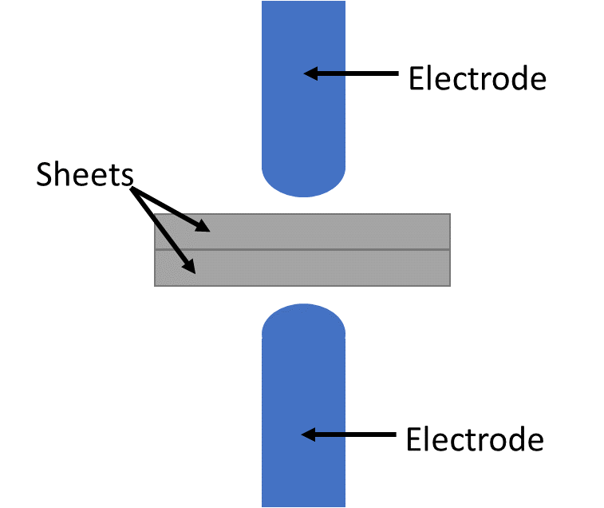
Automotive Body Assembly
Resistance Spot Welding

Slide 4
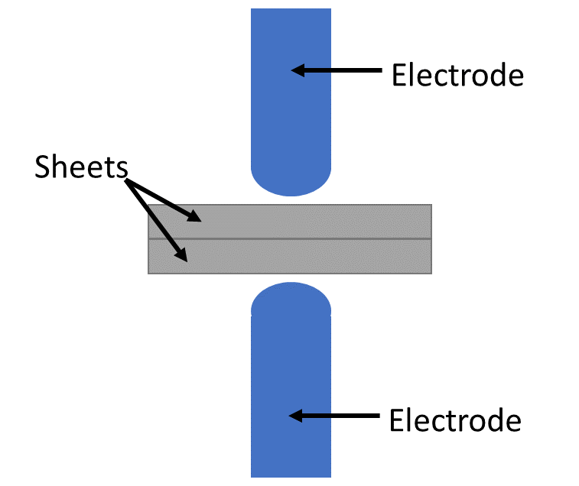
Automotive Body Assembly
Resistance Spot Welding

Slide 5
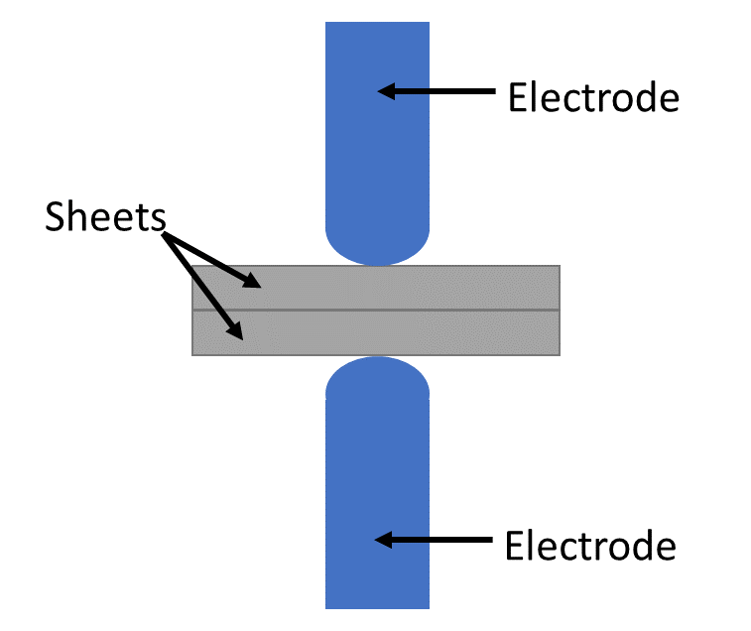
Automotive Body Assembly
Resistance Spot Welding

Slide 6
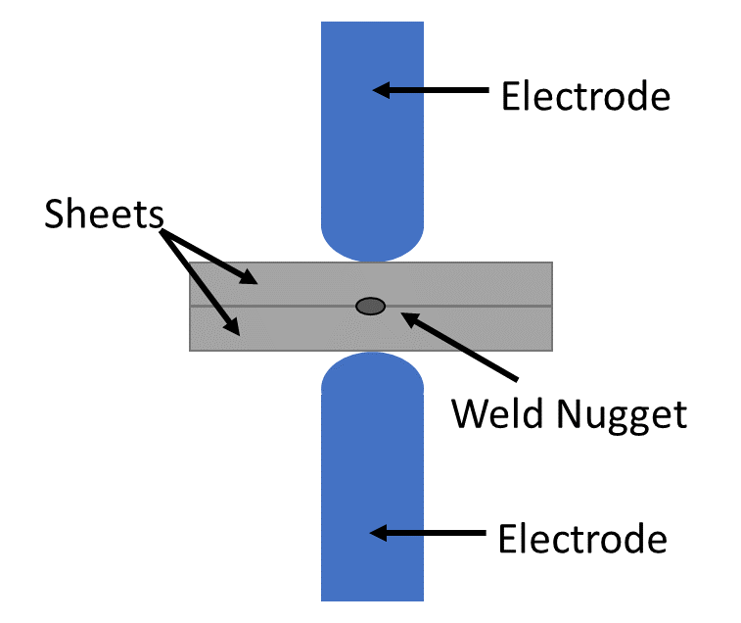
Automotive Body Assembly
Resistance Spot Welding

Slide 7
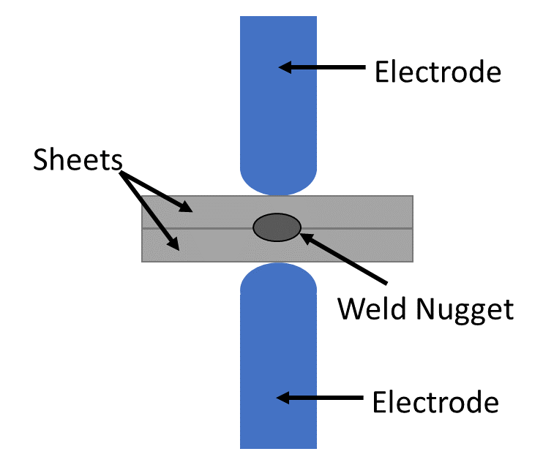
Automotive Body Assembly
Resistance Spot Welding

Slide 8
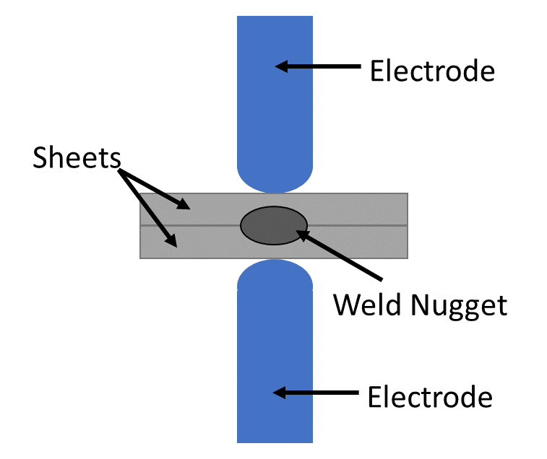
Automotive Body Assembly
Resistance Spot Welding

Slide 9
Automotive Body Assembly
Resistance Spot Welding

Slide 10
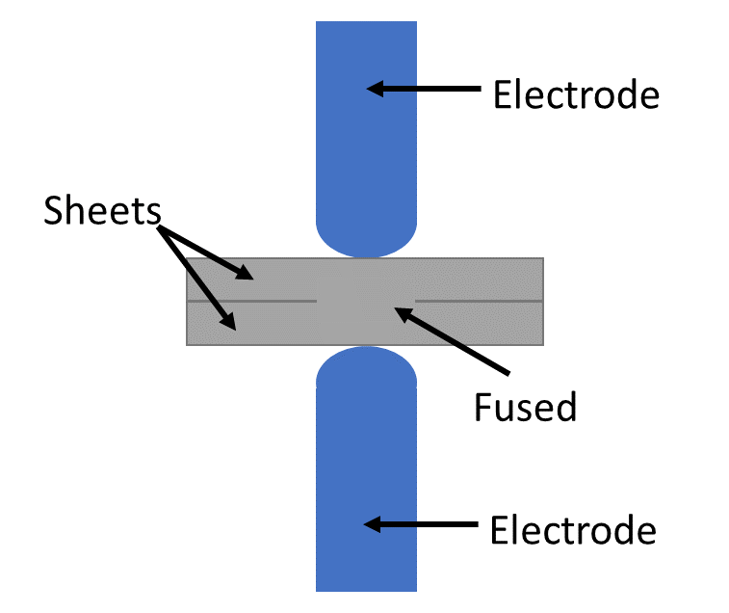
Automotive Body Assembly
Resistance Spot Welding

Slide 11
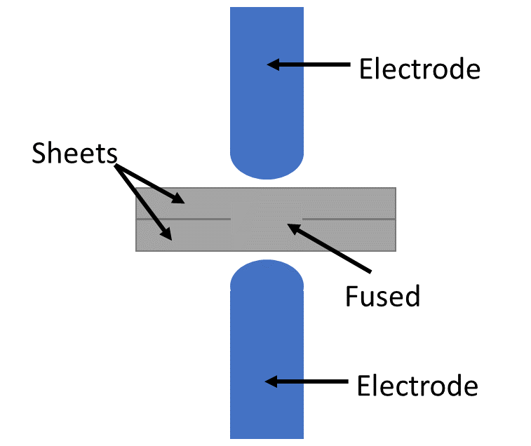
Automotive Body Assembly
Resistance Spot Welding

Slide 12
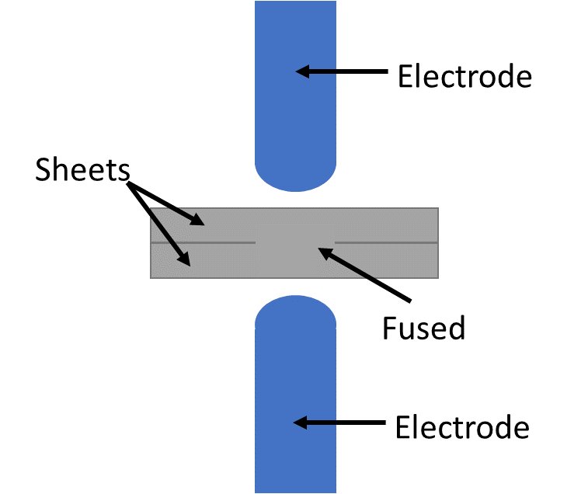
Automotive Body Assembly
Resistance Spot Welding

Slide 13
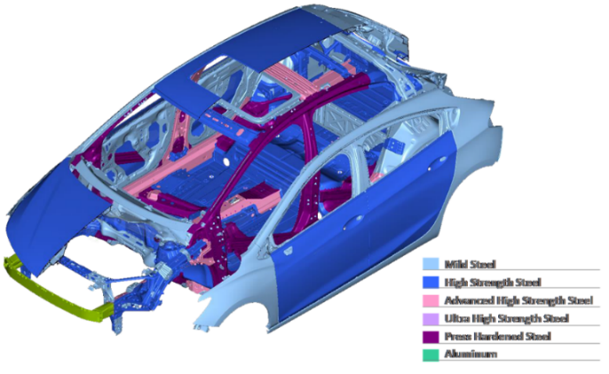
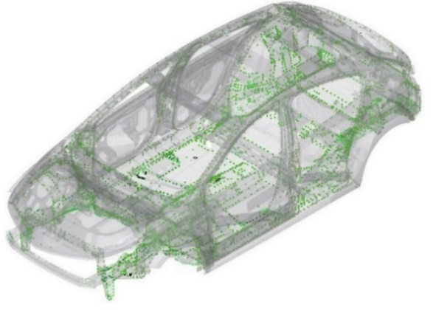
Automotive Body Assembly
Automotive body:
4000-6000 RSWs per vehicle
Many different types of materials
Many different sheet thickness combinations
Weld conditions affect joint quality
E.g. local density of welds, part curvature, etc.

Slide 14
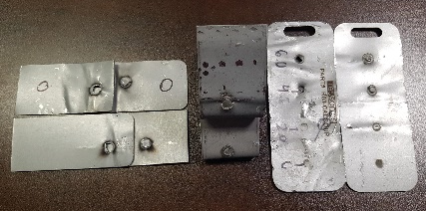
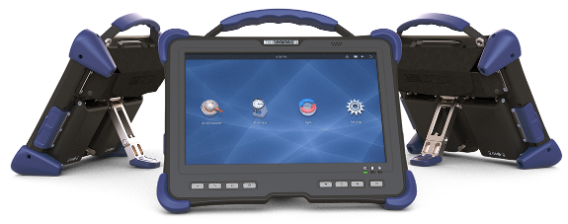
Automotive Body Assembly
Evaluation of Resistance Spot Welds
Old way: statistical destructive testing
Wasteful, slow, expensive
Typical current practice: statistical DT + post-process NDE
Going forward:
Semi- or fully-automated post- or in-process NDE
Using artificial intelligence to automate NDE data interpretation
Toward Industry/NDE 4.0 aim of zero-defect manufacturing

Slide 15
Automotive Body Assembly
Post-process automated assessment allows:
100% inspection of parts
100% traceability
Ability to apply high-level analyses and acceptance logic
Between welds for process refinement
Across positions on a given part
Across parts at a given weld position
To identify process/systematic issues

Slide 16
Automotive Body Assembly
In-process automated assessment allows:
Immediate, constant feedback throughout welding process
Process regulation
Zero-defect welding
Significantly more difficult than post-process
Needs real-time in-process NDE data acquisition
Intense time/computational constraints for interpretation
Understanding what to identify and feed back
Understanding how to adapt to feedback

Slide 17
Automotive Body Assembly
Goal:
Real-time in-process ultrasonic NDE data acquisition and interpretation
As a means of process monitoring
With constant feedback to weld controller
As a means of perfectly welding 100% of welds

Slide 18
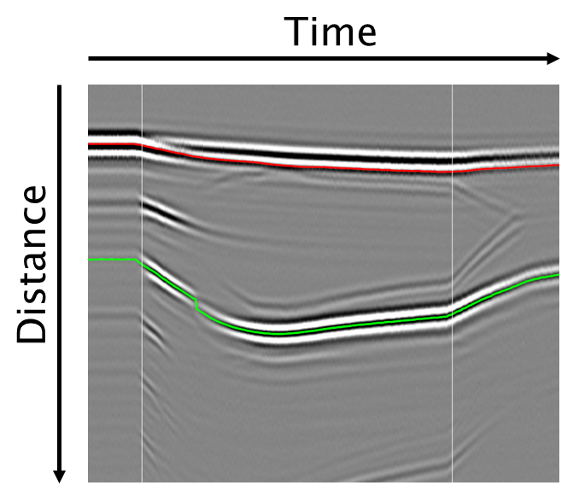
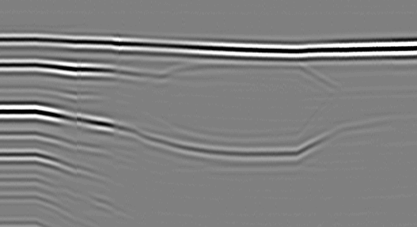
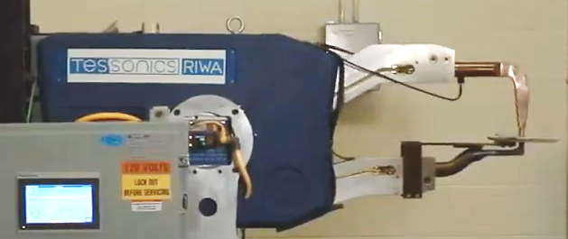
RIWA
Real-time integrated weld analyzer
Uses single-element ultrasonic probe
Produces 2D representation of weld progress over time
Ultrasonic data are produced in-process and real-time

Slide 19
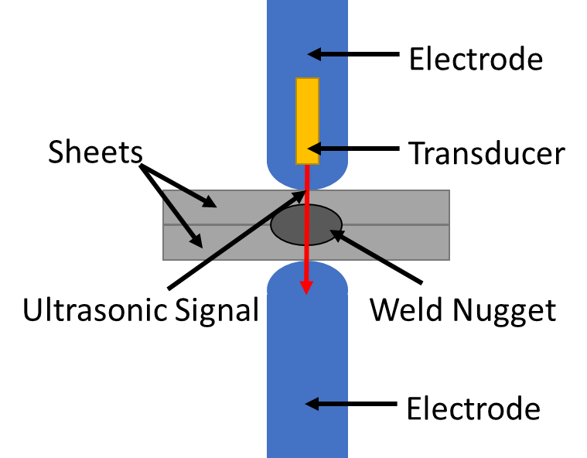
RIWA
Real-time integrated weld analyzer
Uses single-element ultrasonic probe
Produces 2D representation of weld progress over time
Ultrasonic data are produced in-process and real-time

Slide 20
RIWA
Real-time integrated weld analyzer
Uses single-element ultrasonic probe
Produces 2D representation of weld progress over time
Ultrasonic data are produced in-process and real-time

Slide 21
RIWA
Real-time integrated weld analyzer
Uses single-element ultrasonic probe
Produces 2D representation of weld progress over time
Ultrasonic data are produced in-process and real-time

Slide 22
RIWA
Real-time integrated weld analyzer
Uses single-element ultrasonic probe
Produces 2D representation of weld progress over time
Ultrasonic data are produced in-process and real-time

Slide 23
RIWA
Real-time integrated weld analyzer
Uses single-element ultrasonic probe
Produces 2D representation of weld progress over time
Ultrasonic data are produced in-process and real-time

Slide 24
RIWA
Real-time integrated weld analyzer
Uses single-element ultrasonic probe
Produces 2D representation of weld progress over time
“A-scan” – 1D time slice of image

Slide 25
RIWA
Real-time integrated weld analyzer
Uses single-element ultrasonic probe
Produces 2D representation of weld progress over time
“A-scan” – 1D time slice of image

Slide 26
RIWA
Real-time integrated weld analyzer
Uses single-element ultrasonic probe
Produces 2D representation of weld progress over time
“A-scan” – 1D time slice of image

Slide 27
RIWA
Real-time integrated weld analyzer
Uses single-element ultrasonic probe
Produces 2D representation of weld progress over time
“A-scan” – 1D time slice of image

Slide 28
RIWA
Real-time integrated weld analyzer
Uses single-element ultrasonic probe
Produces 2D representation of weld progress over time
“A-scan” – 1D time slice of image

Slide 29
RIWA
Real-time integrated weld analyzer
Uses single-element ultrasonic probe
Produces 2D representation of weld progress over time
“B-scan” – 2D image made by horizontally stacking A-scans

Slide 30
RIWA
Some observable entities:
Top of welded stack
Top of molten nugget
Sheet interfaces
Bottom of molten nugget
Bottom of welded stack

Slide 31
RIWA
Some observable entities:
Top of welded stack
Top of molten weld nugget
Sheet interfaces
Bottom of molten weld nugget
Bottom of welded stack

Slide 32
RIWA
Some observable entities:
Top of welded stack
Top of molten weld nugget
Sheet interfaces
Bottom of molten weld nugget
Bottom of welded stack

Slide 33
RIWA
Some observable entities:
Top of welded stack
Top of molten weld nugget
Sheet interfaces
Bottom of molten weld nugget
Bottom of welded stack

Slide 34
RIWA
Some observable entities:
Top of welded stack
Top of molten weld nugget
Sheet interfaces
Bottom of molten weld nugget
Bottom of welded stack

Slide 35
RIWA
Some observable entities:
Top of welded stack
Top of molten weld nugget
Sheet interfaces
Bottom of molten weld nugget
Bottom of welded stack

Slide 36
RIWA
Some observable weld process events:
A) Beginning of application of current
B) Onset of molten weld nugget formation
C) Molten weld nugget breaching steel-steel interface
D) Vertical saturation of molten weld nugget
E) End of current
F) Solidification of weld nugget
A B C D E F

Slide 37
RIWA
Some observable weld process events:
A) Beginning of current
B) Onset of molten nugget formation
C) Molten nugget breaching steel-steel interface
D) Vertical saturation of molten weld nugget
E) End of current
F) Solidification of nugget
A

Slide 38
RIWA
Some observable weld process events:
A) Beginning of current
B) Onset of molten nugget formation
C) Molten nugget breaching steel-steel interface
D) Vertical saturation of molten weld nugget
E) End of current
F) Solidification of nugget
B

Slide 39
RIWA
Some observable weld process events:
A) Beginning of current
B) Onset of molten nugget formation
C) Molten nugget breaching steel-steel interface
D) Vertical saturation of molten weld nugget
E) End of current
F) Solidification of nugget
C

Slide 40
RIWA
Some observable weld process events:
A) Beginning of current
B) Onset of molten nugget formation
C) Molten nugget breaching steel-steel interface
D) Vertical saturation of molten weld nugget
E) End of current
F) Solidification of nugget
D

Slide 41
RIWA
Some observable weld process events:
A) Beginning of current
B) Onset of molten nugget formation
C) Molten nugget breaching steel-steel interface
D) Vertical saturation of molten weld nugget
E) End of current
F) Solidification of nugget
E

Slide 42
RIWA
Some observable weld process events:
A) Beginning of current
B) Onset of molten nugget formation
C) Molten nugget breaching steel-steel interface
D) Vertical saturation of molten weld nugget
E) End of current
F) Solidification of nugget
F

Slide 43
RIWA
Idea:
Automate characterization of ultrasonic data
Relate to physical weld characteristics and weld process events
Predict/determine weld quality
Classical approach:
Unreliable
Slow
Difficult/impossible to program by hand
Solution: Deep Learning

Slide 44
RIWA
Idea:
Automate characterization of ultrasonic data
Relate to physical weld characteristics and weld process events
Predict/determine weld quality
Classical approach:
Unreliable
Slow
Difficult/impossible to program by hand
Solution: Deep Learning
Post-process

Slide 45
RIWA
Idea:
Automate characterization of ultrasonic data
Relate to physical weld characteristics and weld process events
Predict/determine weld quality
Classical approach:
Unreliable
Slow
Difficult/impossible to program by hand
Solution: Deep Learning
In-process

Slide 46
RIWA
Idea:
Automate characterization of ultrasonic data
Relate to physical weld characteristics and weld process events
Predict/determine weld quality
Classical approach:
Unreliable
Slow
Difficult/impossible to program by hand
Solution: Deep Learning
In-process

Slide 47
RIWA
Idea:
Automate characterization of ultrasonic data
Relate to physical weld characteristics and weld process events
Predict/determine weld quality
Classical approach:
Unreliable
Slow
Difficult/impossible to program by hand
Solution: Deep Learning
In-process

Slide 48
RIWA
Idea:
Automate characterization of ultrasonic data
Relate to physical weld characteristics and weld process events
Predict/determine weld quality
Classical approach:
Unreliable
Slow
Difficult/impossible to program by hand
Solution: Deep Learning
In-process

Slide 49
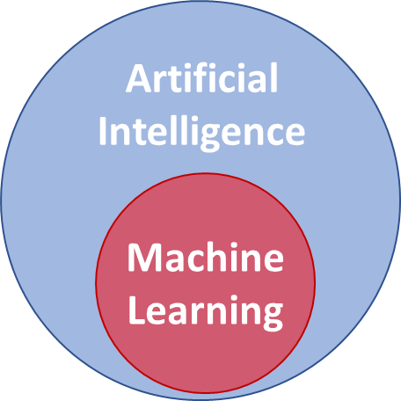
AI, Machine Learning, and Deep Learning
AI: Develops machines that imitate intelligence
Elements of intelligence:
Perception
Reasoning
Problem Solving
Linguistics/Communication
Creativity …
Learning

Slide 50
AI, Machine Learning, and Deep Learning
Machine Learning:
Major branch of AI
Allows computers to learn
Uses mathematical modeling and data-driven algorithms to optimize models

Slide 51
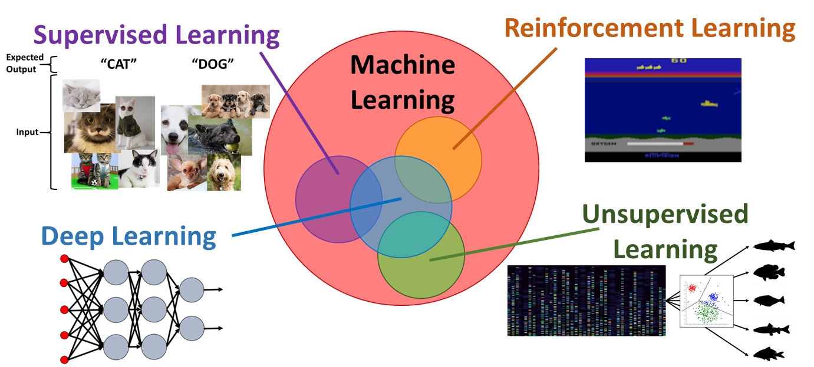
AI, Machine Learning, and Deep Learning
Machine Learning:
Huge, highly active research field
Several different main subfields, many applications

Slide 52
AI, Machine Learning, and Deep Learning
Machine Learning:
Huge, highly active research field
Several different main subfields, many applications

Slide 53
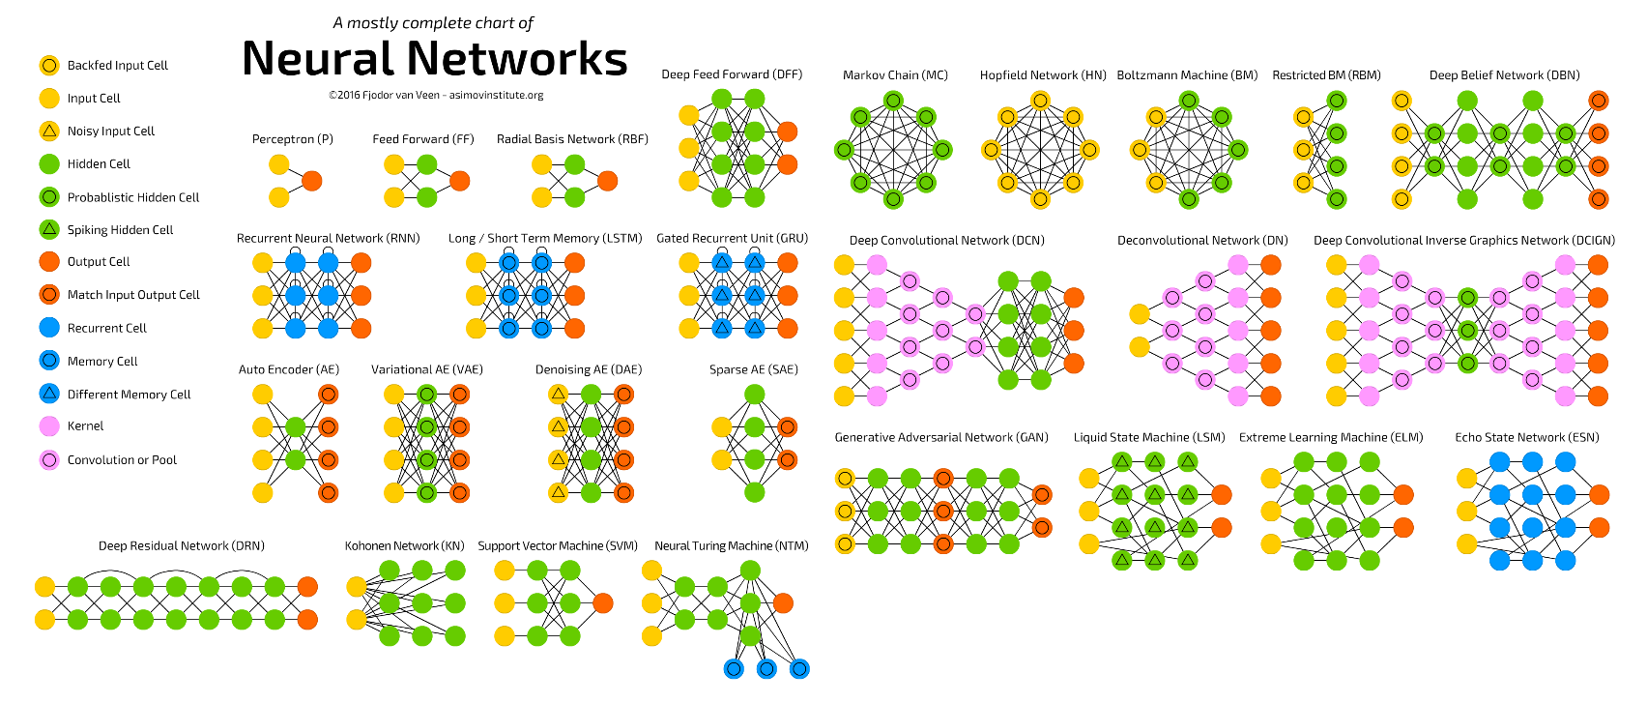
AI, Machine Learning, and Deep Learning
Deep Learning:
Cutting edge of machine learning
Specifically uses deep artificial neural networks

Slide 54
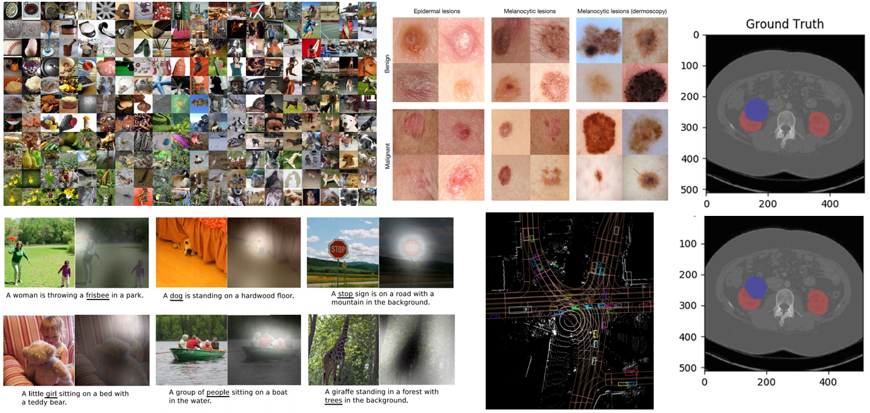
AI, Machine Learning, and Deep Learning
Deep Learning:
State of the art in many problems

Slide 55
AI for Real-Time Ultrasonic
B-scan Characterization
Supervised learning requires “labeled” dataset
Developed >20000 welds with corresponding metadata
E.g. date, time, sheet thicknesses, etc.
Wide variety of weld parameters
E.g. force, weld time, current, etc.
Creates variety in B-scans and resultant weld size
Labeled data for task of real-time characterization
Annotate samples with key events and positions
Modeled nugget growth curves as proportion of stack in time

Slide 56
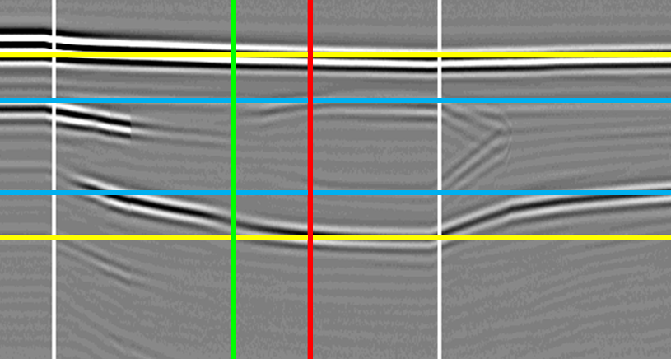
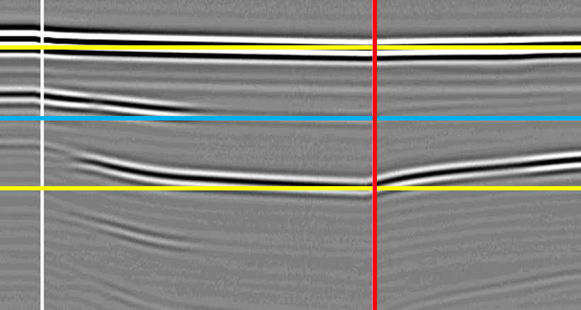
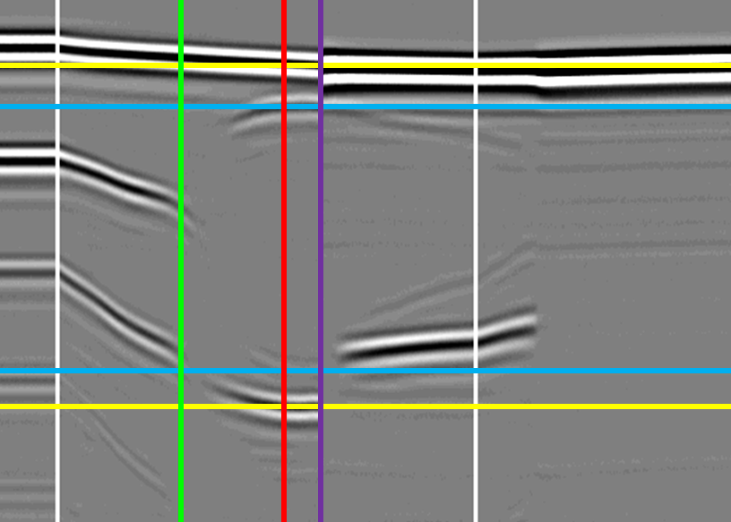
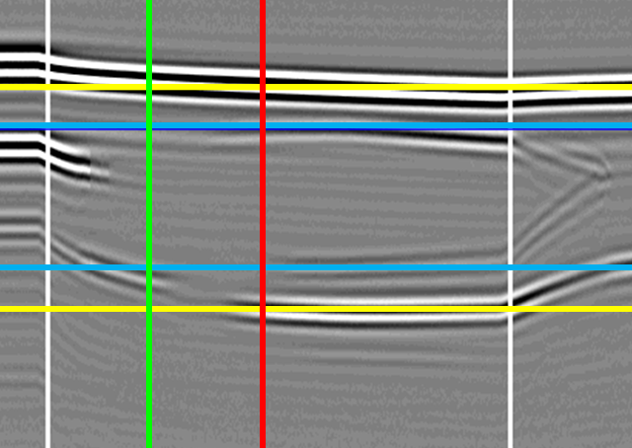
AI for Real-Time Ultrasonic
B-scan Characterization
Labeled data:

Slide 57
AI for Real-Time Ultrasonic
B-scan Characterization
Model development
Selection & optimization of model architecture
Evaluated feasibility in terms of inference speed
Used classical algorithms to train deep neural networks
Used classical approaches to evaluate/compare models
Evaluated:
Detection rates and false negatives of events
Timeliness of event detection
Accuracy of nugget penetration proportional to stack (±10%)

Slide 58
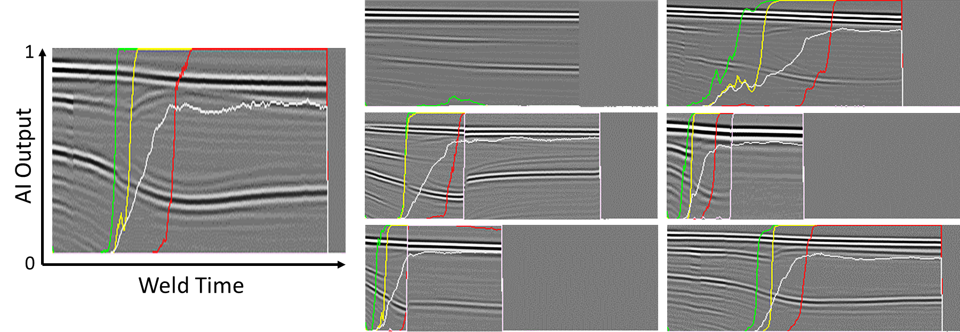
AI for Real-Time Ultrasonic
B-scan Characterization
Results:

Slide 59
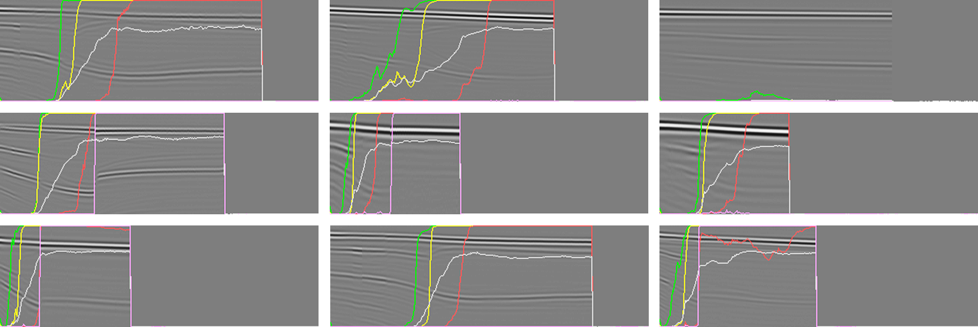
AI for Real-Time Ultrasonic
B-scan Characterization
Results:

Slide 60
AI for Real-Time Ultrasonic
B-scan Characterization
Results:

Slide 61
AI for Real-Time Ultrasonic
B-scan Characterization
Results:
Detection rates (within 10ms, 30ms)
Onset of molten nugget formation (91.5%, 98.2%)
Breach of steel-steel interface (91.9%, 98.5%)
Saturation (75.4%, 92%)
Expulsion occurrence (96.7%, 98.4%)
Accuracy of molten nugget penetration as proportion of stack ±10% = 90.2%
Inference time = 0.5ms per A-scan

Slide 62
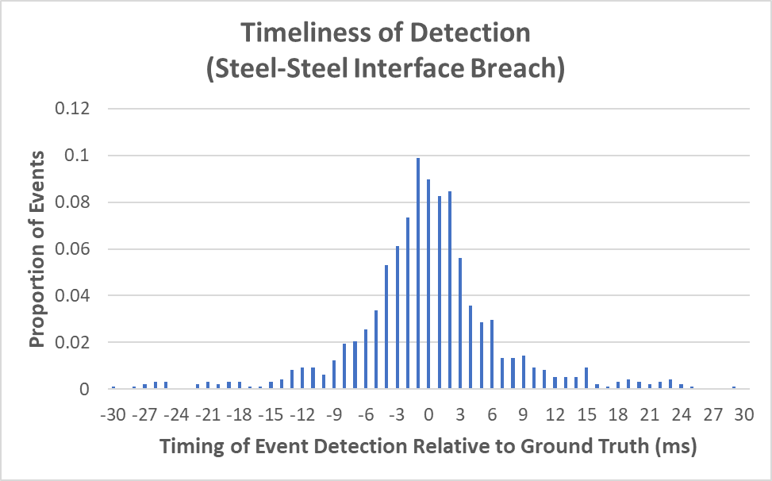
AI for Real-Time Ultrasonic
B-scan Characterization
Results:

Slide 63
AI for Real-Time Ultrasonic
B-scan Characterization
Enables:
100% traceability of welds
Predictive maintenance (e.g. weld electrode cap wear)
Trend analysis by part or by weld
Automated process control (in-process or post-process)

Slide 64
AI for Real-Time Ultrasonic
B-scan Characterization
Industrial application:
Real-time resistance spot weld process control
Feedback to the weld controller
Weld controller makes decisions based on state of weld as reported by AI via interpretation of ultrasonic B-scan
Increase/stabilize current
Adjust weld time
Etc.
Truly adaptive welding with constant feedback
Zero defect resistance spot welding

Slide 65
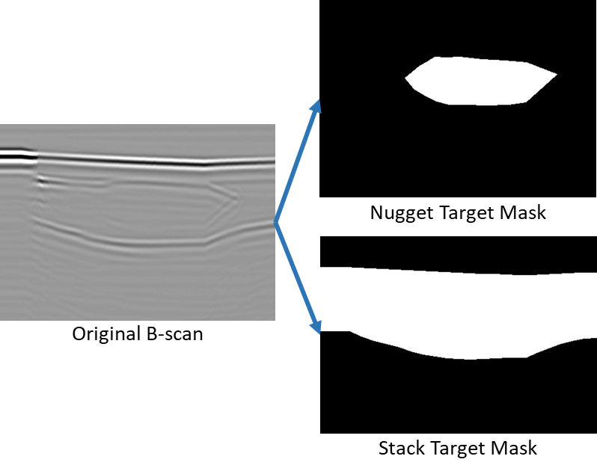
Next Generation of AI
Measure lateral nugget growth throughout welding
Improve AI approach
Enhanced nugget/stack model
Exact nugget vertical position in stack throughout weld
Better relationships with physical product/process
Consequently, more informative weld evaluation

Slide 66
References
obara.co.kr
asimovinstitute.org/neural-network-zoo
Baccan F (2017), Platform Presentation Brasil. http://portal.saebrasil.org.br/Eventos/Geral/Palestra/Carbody-2017
Esteva, A., Kuprel, B., Novoa, R. et al. Dermatologist-level classification of skin cancer with deep neural networks. Nature 542, 115–118 (2017). https://doi.org/10.1038/nature21056
Müller D, Kramer F. MIScnn: a framework for medical image segmentation with convolutional neural networks and deep learning. BMC Med Imaging. 2021 Jan 18;21(1):12. doi: 10.1186/s12880-020-00543-7. PMID: 33461500; PMCID: PMC7814713.
Maev, R., Chertov, A., Scott, R., Stocco, D., Ouellette, A., Denisov, A., Oberdoerfer, Y. (2020) NDE in the Automotive Sector. in Handbook of Nondestructive Evaluation 4.0.
Xu, K., Ba, J., Kiros, R., Cho, K., Courville, A., Salakhudinov, R., Zemel, R. & Bengio, Y.. (2015). Show, Attend and Tell: Neural Image Caption Generation with Visual Attention. Proceedings of the 32nd International Conference on Machine Learning, in Proceedings of Machine Learning Research 37:2048-2057
Mnih et al. (2013) Playing Atari with Deep Reinforcement Learning. NIPS Deep Learning Workshop 2013.
argo.ai
http://karpathy.github.io

Slide 67
Acknowledgements
Thanks!

